Slide 1

CCDPH Community Health Status Assessment
Alfreda Holloway-Beth, PhD, MS
Director of Epidemiology
October 13, 2021

Slide 2
Purpose & Organization of the CCDPH’s Community Health Status Assessment
The purpose of the CHSA is to inform public health planning as well as to comply with its five‐year accreditation through the Public Health Accreditation Board.
We follow the Mobilizing for Action through Planning and Partnerships (MAPP) framework created by the National Association of County and City Health Officials (NACCHO); a framework facilitated by public health leaders to help communities apply strategic thinking to prioritize public health issues and identify resources to address them.
We employ a comprehensive data collection, analysis and synthesis approach to operationalize and present selected indicators in such a way that is both meaningful to stakeholders and assists in better integrating health equity and community engagement into the public health process.
Notes:
The document aims to provide a rich, multi‐dimensional account of the health status of CCDPH residents to aid with problem and asset identification and policy formulation, implementation, and evaluation.

Slide 3
CHSA| Data Sources
The indicators presented in this assessment rely on a wide variety of secondary data made available from both public and private sources.
US Census Bureau’s American Community Survey (ACS)
Institute of Housing Studies at DePaul University
Illinois Department of Public Health Vital Statistics
Chicago Metropolitan Agency for
Planning
Principal Datasets and Sources
Other Sources
US Environmental Protection Agency
Illinois County Behavioral Risk Factor Surveys Round 6 (2015‐2019) County Report
Center for Neighborhood Technology
CDC PLACES, 2020
Center for Disease Control & Prevention
Notes:
Through COVID and health equity funding, the unit is engaged in developing its capacity in COVID-19 vaccine management of provider data, Behavioral Risk among Youth with special interested in vaping & electronic cigarettes (building out case investigation); CSTE fellowships; an opportunity (health equity); CCVI; mobile data dashboard; phases; seasonal population report; red cap registration, interested in getting vaccination, form-app, sign, emergency contact registration form; phone bank analysis; data team for COVID

Slide 4
Components of the CCDPH’s Community Health Status Assessment
The CHSA presents and summarizes data for several inter‐related indicators across ten topic categories that are further organized into two sections, namely:
social and structural determinants of health; and
health behaviors, outcomes and trends.

Slide 5
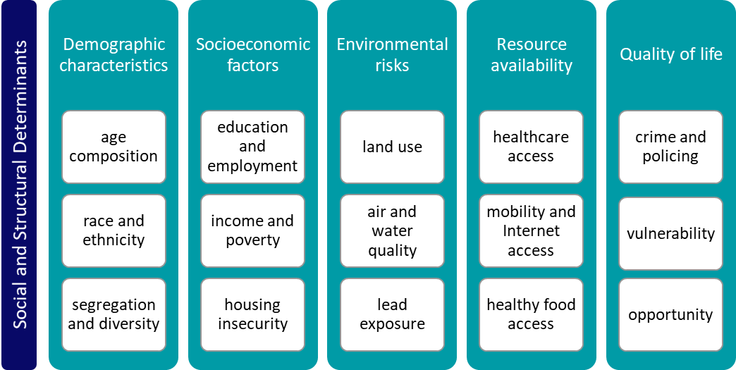
CHSA Indicators by Topic Category and Section

Slide 6
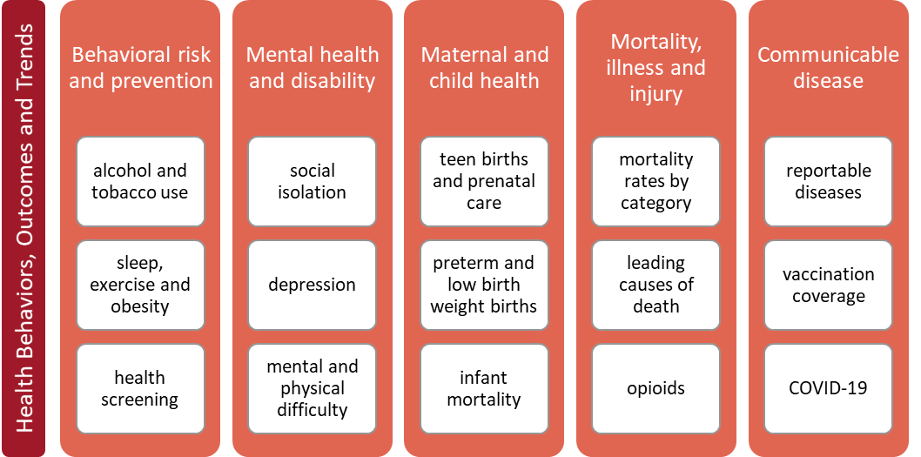
CHSA Indicators by Topic Category and Section

Slide 7
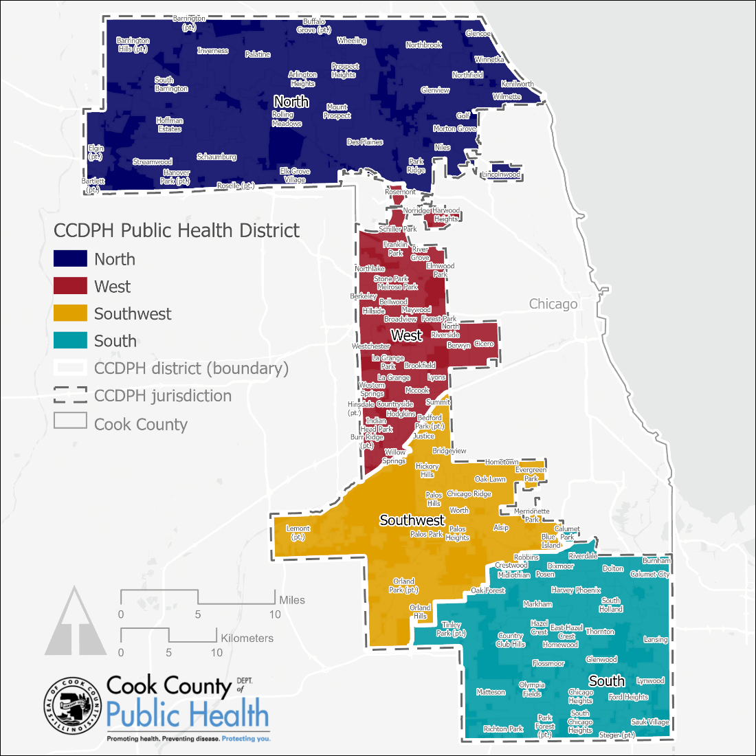
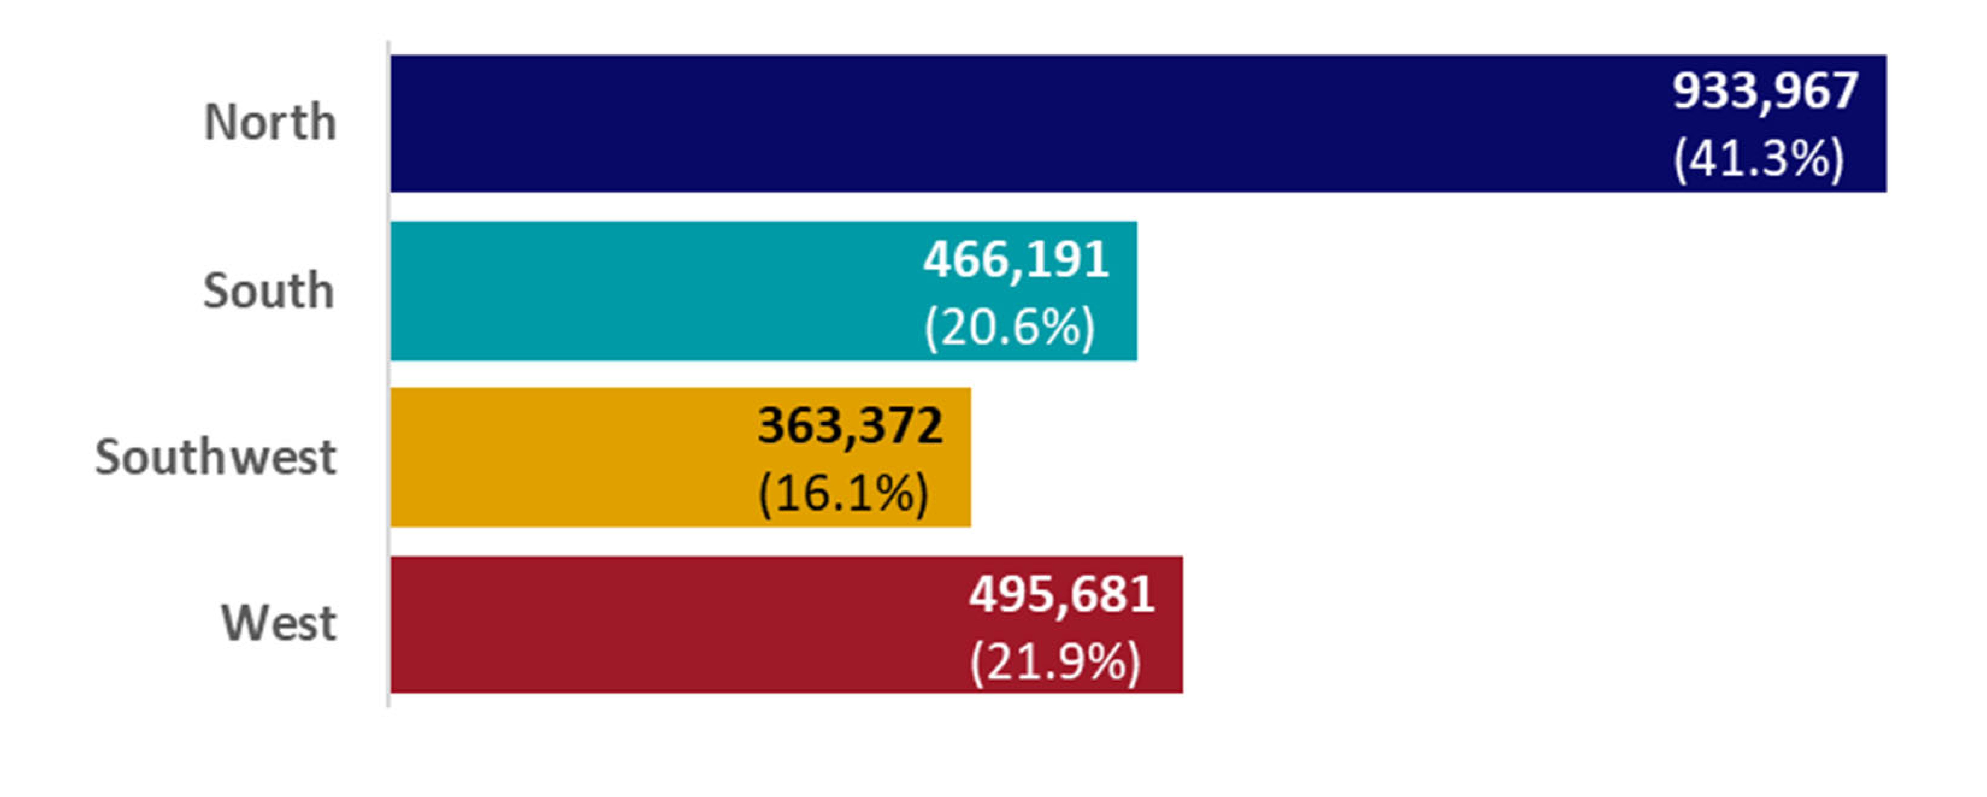
CCDPH Population & Jurisdiction by District, 2019
CCDPH jurisdiction four CCDPH districts: north, west, southwest and south. These districts are used by CCDPH to evaluate and compare social, demographic and health patterns across its jurisdiction.
Data source: U.S. Census Bureau (2019). Sex by Age (Table B01001), 2015‐2019 American Community Survey 5‐year estimates.

Slide 8
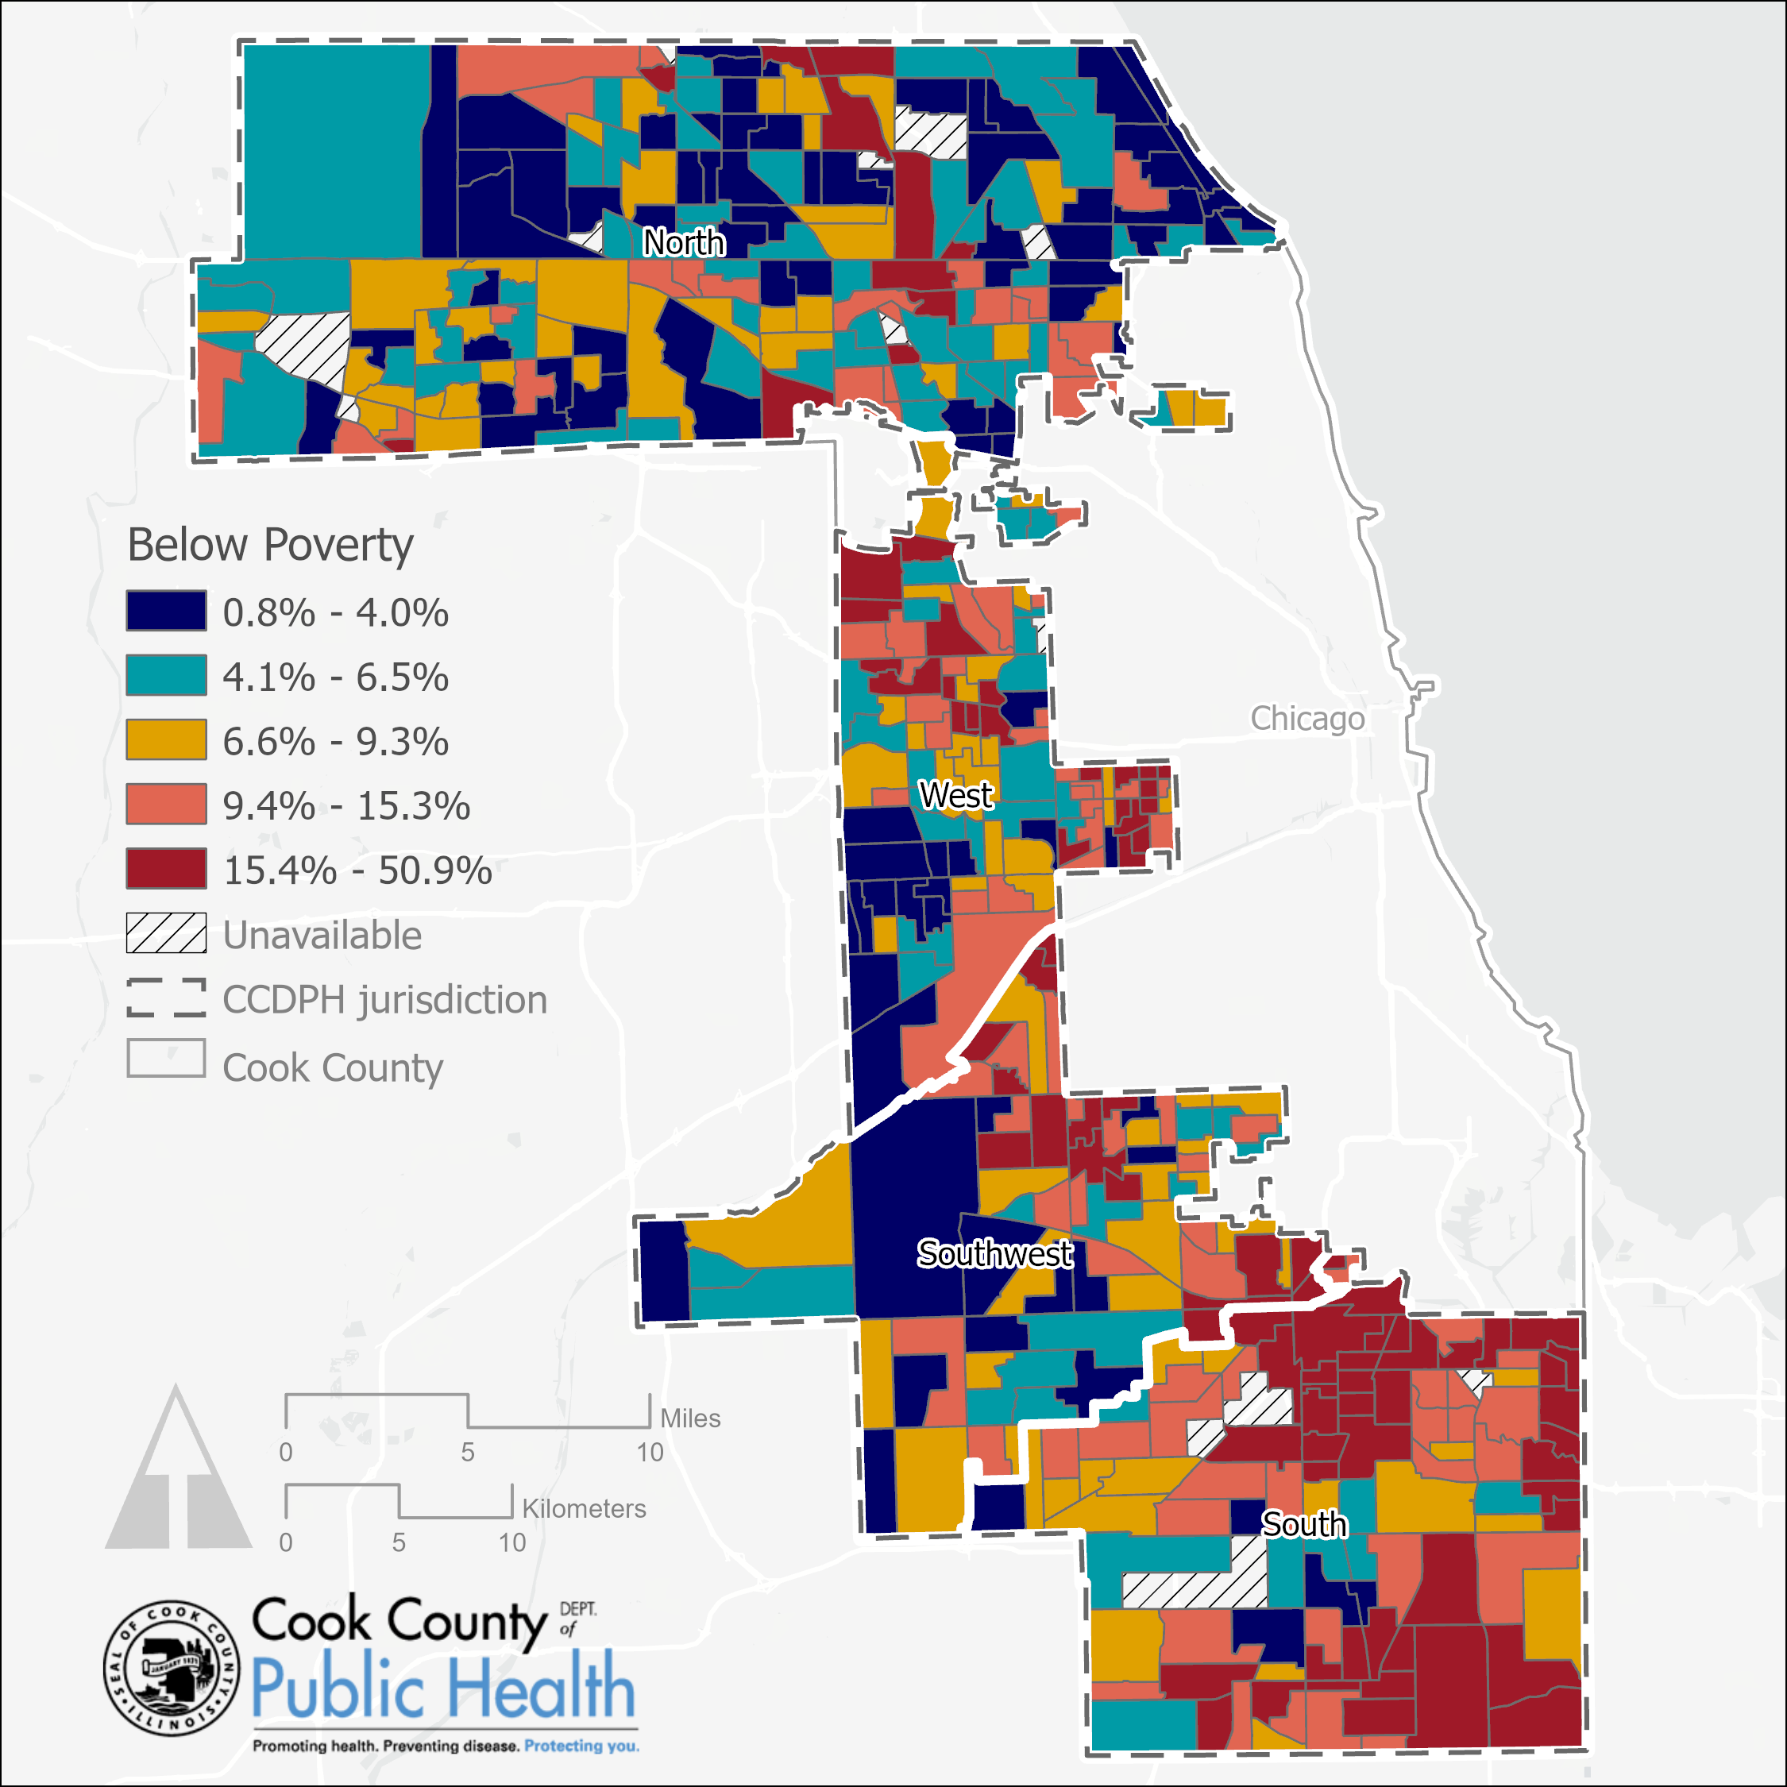
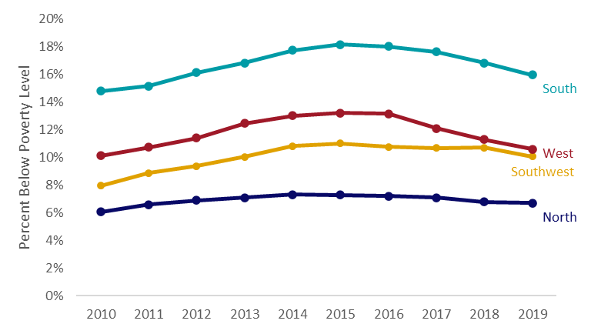
Percent of Population Living in Households Earning Below Poverty Level Income
Residents within CCDPH’s south district had the greatest proportion of individuals living under the federal poverty line in 2019 (16%); over twice the rate estimated for the population residing in CCDPH’s north district (7%).
Data source: U.S. Census Bureau (2015–2019). Poverty Status by Sex by Age (Table B17001), 2015–2019 American Community Survey five-year estimates..

Slide 9
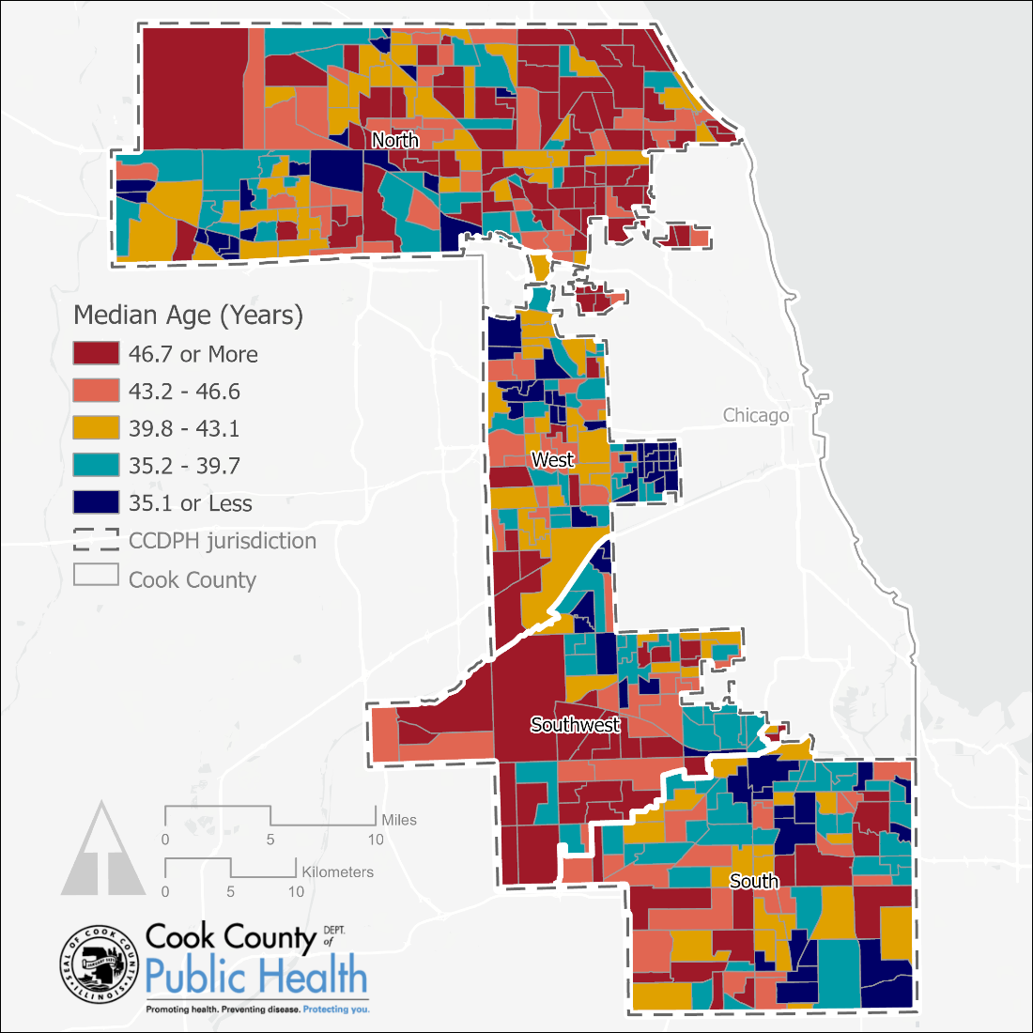
Median Age
The median age of the population varies considerably throughout CCDPH’s jurisdiction with neighborhoods in the north and southwest districts having considerably older populations than their counterparts residing in the west and south.
Data source: U.S. Census Bureau (2015-2019). Median Age (Table B01002), 2015–2019 American Community Survey five-year estimates.

Slide 10
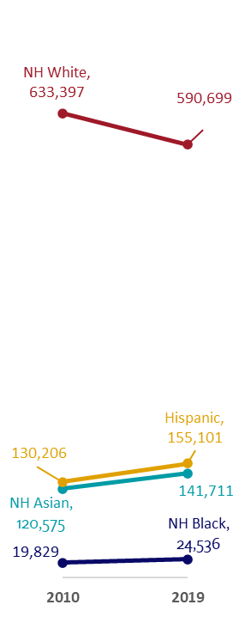
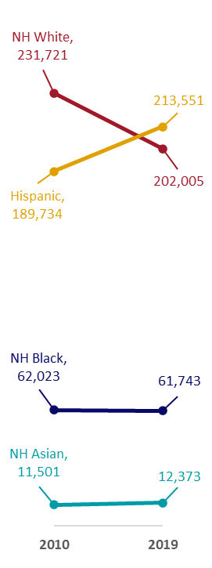
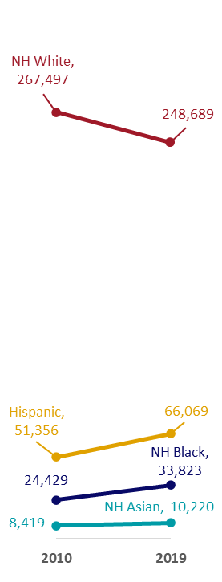
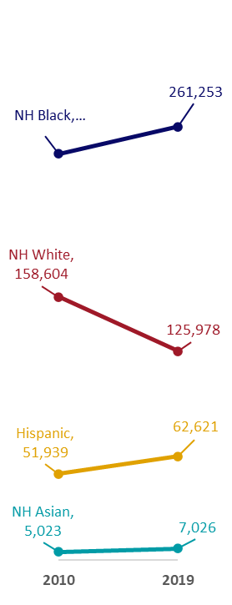
Change in Population by Race, Ethnicity and CCDPH’s Public Health District, 2010-2019
North
West
Southwest
South
Data source: U.S. Census Bureau (2010-2019). Hispanic or Latino by Race (Table B03002), 2006-2010 through 2015-2019 American Community Survey 5-year estimates.

Slide 11
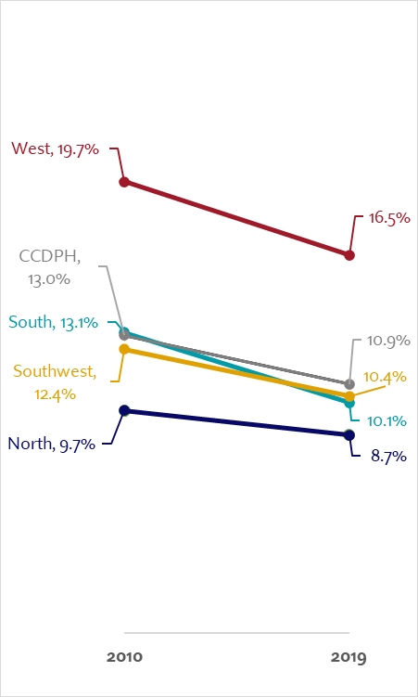
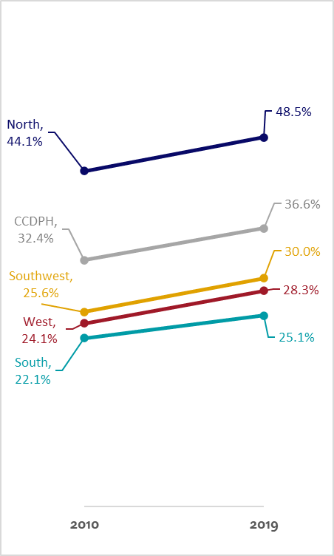
Educational Attainment by CCDPH’s Public Health District, 2010-2019
Less than a High School Diploma
At Least a Bachelor’s Degree
Data source: U.S. Census Bureau (2010-2019). Sex by Education Attainment (Table B15002), 2006-2010 through 2015-2019 American Community Survey 5-year estimates.

Slide 12

Percent of Population in Households Earning Below Poverty Level Income
While each public CCDHP district contains variation in the percent of the population with incomes below the federal poverty level (FPL), the north district has the fewest census tracts with average incomes below FPL and the south district has the most census tracts with average incomes above FPL.
Data source: U.S. Census Bureau (2015-2019). Sex by Age by Employment Status for the Population 16 Years and Over (Table B23001), 2015-2019 American Community Survey 5-year estimates.

Slide 13
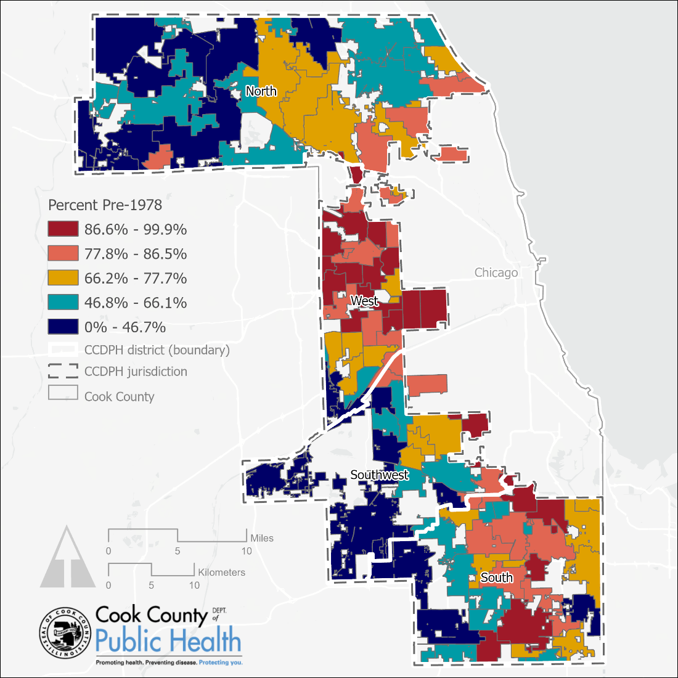
Percent of Housing Units with Lead Paint Risk
This map shows the percentage of housing units that were built prior to 1978, the year when that lead-containing paint was from consumer settings. Over 8 in 10 municipalities in CCDPH’s jurisdiction have over 50 percent of their housing stock built before 1978. Many of the older suburbs in the South and West districts have even older housing stocks, heightening the potential for lead paint exposure to residents.
Data source: U.S. Census Bureau (2015-2019). Sex by Age by Employment Status for the Population 16 Years and Over (Table B23001), 2015-2019 American Community Survey 5-year estimates.
Data source: Cook County Assessor (2021).

Slide 14
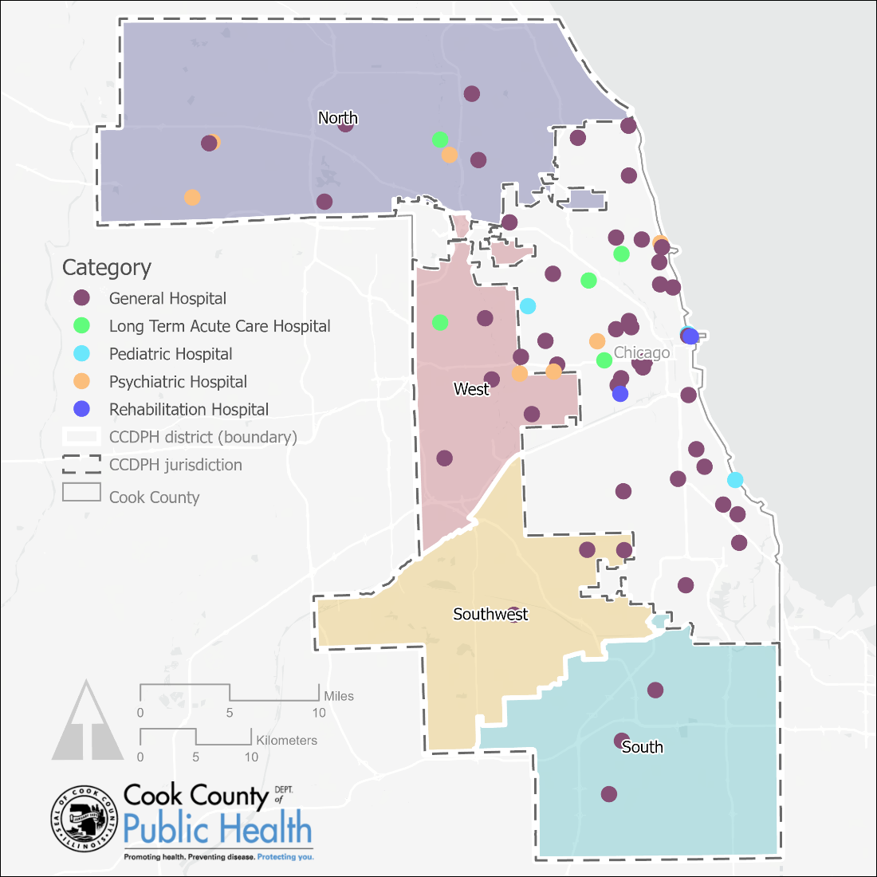
Licensed Hospitals in Cook County, 2021
As of 2021, the concentration of hospitals of all types is lower throughout Suburban Cook County districts when compared to the City of Chicago. General hospitals are the most common hospital type throughout the county. The north district contained the most variety of hospital types, and the fewest hospitals were located in the southwest and south districts.
Data source: Illinois Department of Public Health, Licensed Hospital Directory (2021).

Slide 15
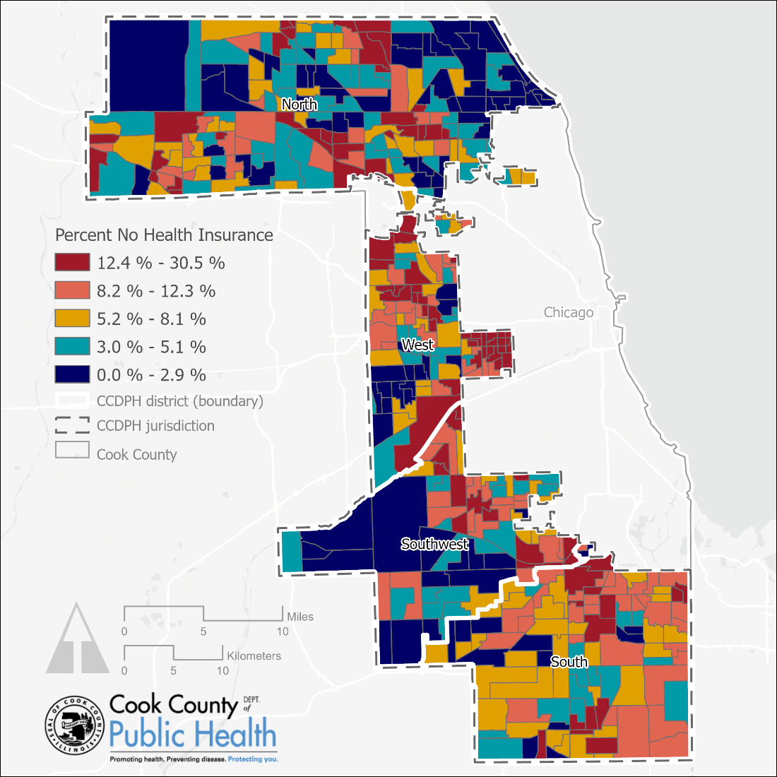
Percent No Health Insurance, 2019
Several communities across CCDPH’s jurisdiction reported high rates of uninsured population, with sizable clusters in each of the four public districts.
Data source: 2015-2019 American Community Survey 5-year estimates (Table S2701).

Slide 16
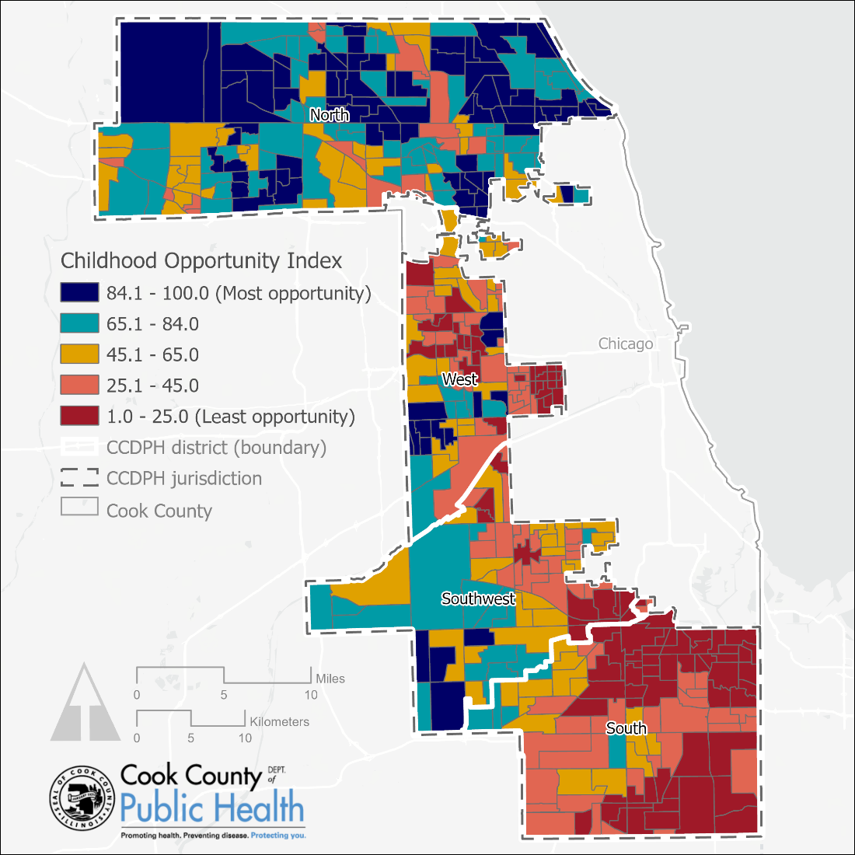

Childhood Opportunity Index
Clusters of high childhood opportunity were found predominantly in the north district, though clusters of high opportunity were also observed in the west and southwest districts. The west and south districts contain the highest concentration of census tracts with low childhood opportunity scores.
Data source: Diversity Data for Kids Childhood Opportunity Index 2.0 (2015).

Slide 17
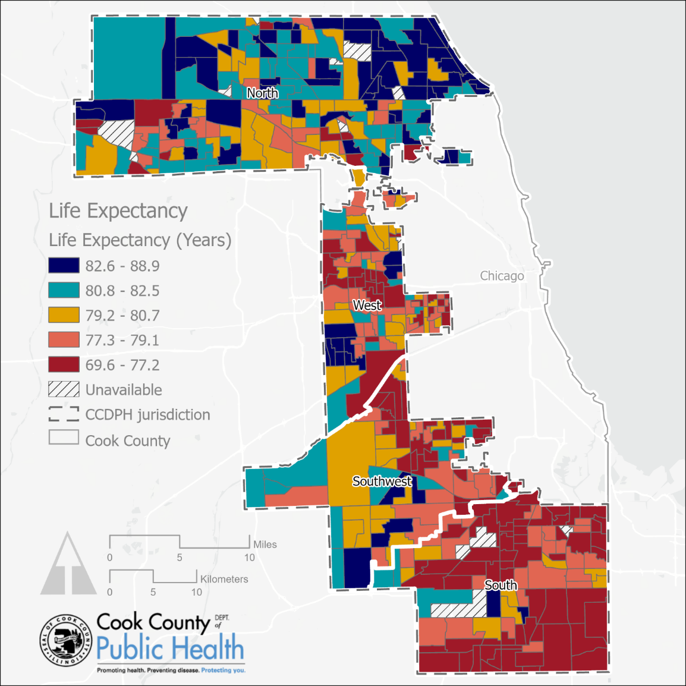
Life Expectancy at Birth
The North district contains the highest concentration of census tracts with higher concentrations of populations with longer life expectancy. The South district contains the highest proportion of census tracts with comparatively lower life expectancies.
Data source: United States Life Expectancy Estimation Project (USALEEP, 2020).

Slide 18
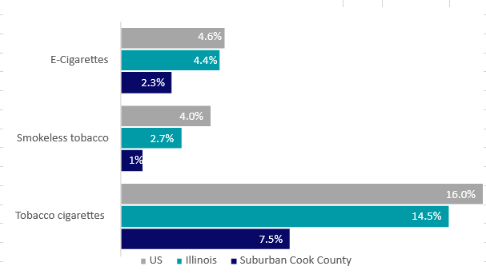
CHSA| Health Behaviors & Outcomes
Behavioral Risk & Prevention – Healthcare Utilization by Category for Suburban Cook County, Illinois and U.S.
Data sources: BRFSS 2017, 2019; ICBRFS, Round 6 (Collected 2015–2019).
Notes:
Tobacco use is considerably lower among residents of Suburban Cook County compared to the State of Illinois and the US as a whole.

Slide 19
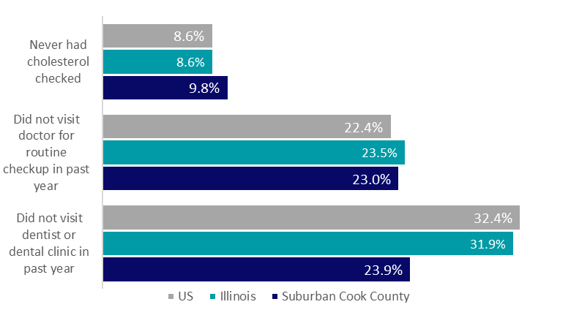
CHSA| Health Behaviors & Outcomes
Behavioral Risk & Prevention – Healthcare Utilization by Category for Suburban Cook County, Illinois and U.S.
Data sources: BRFSS 2017, 2019; ICBRFS, Round 6 (Collected 2015–2019).

Slide 20
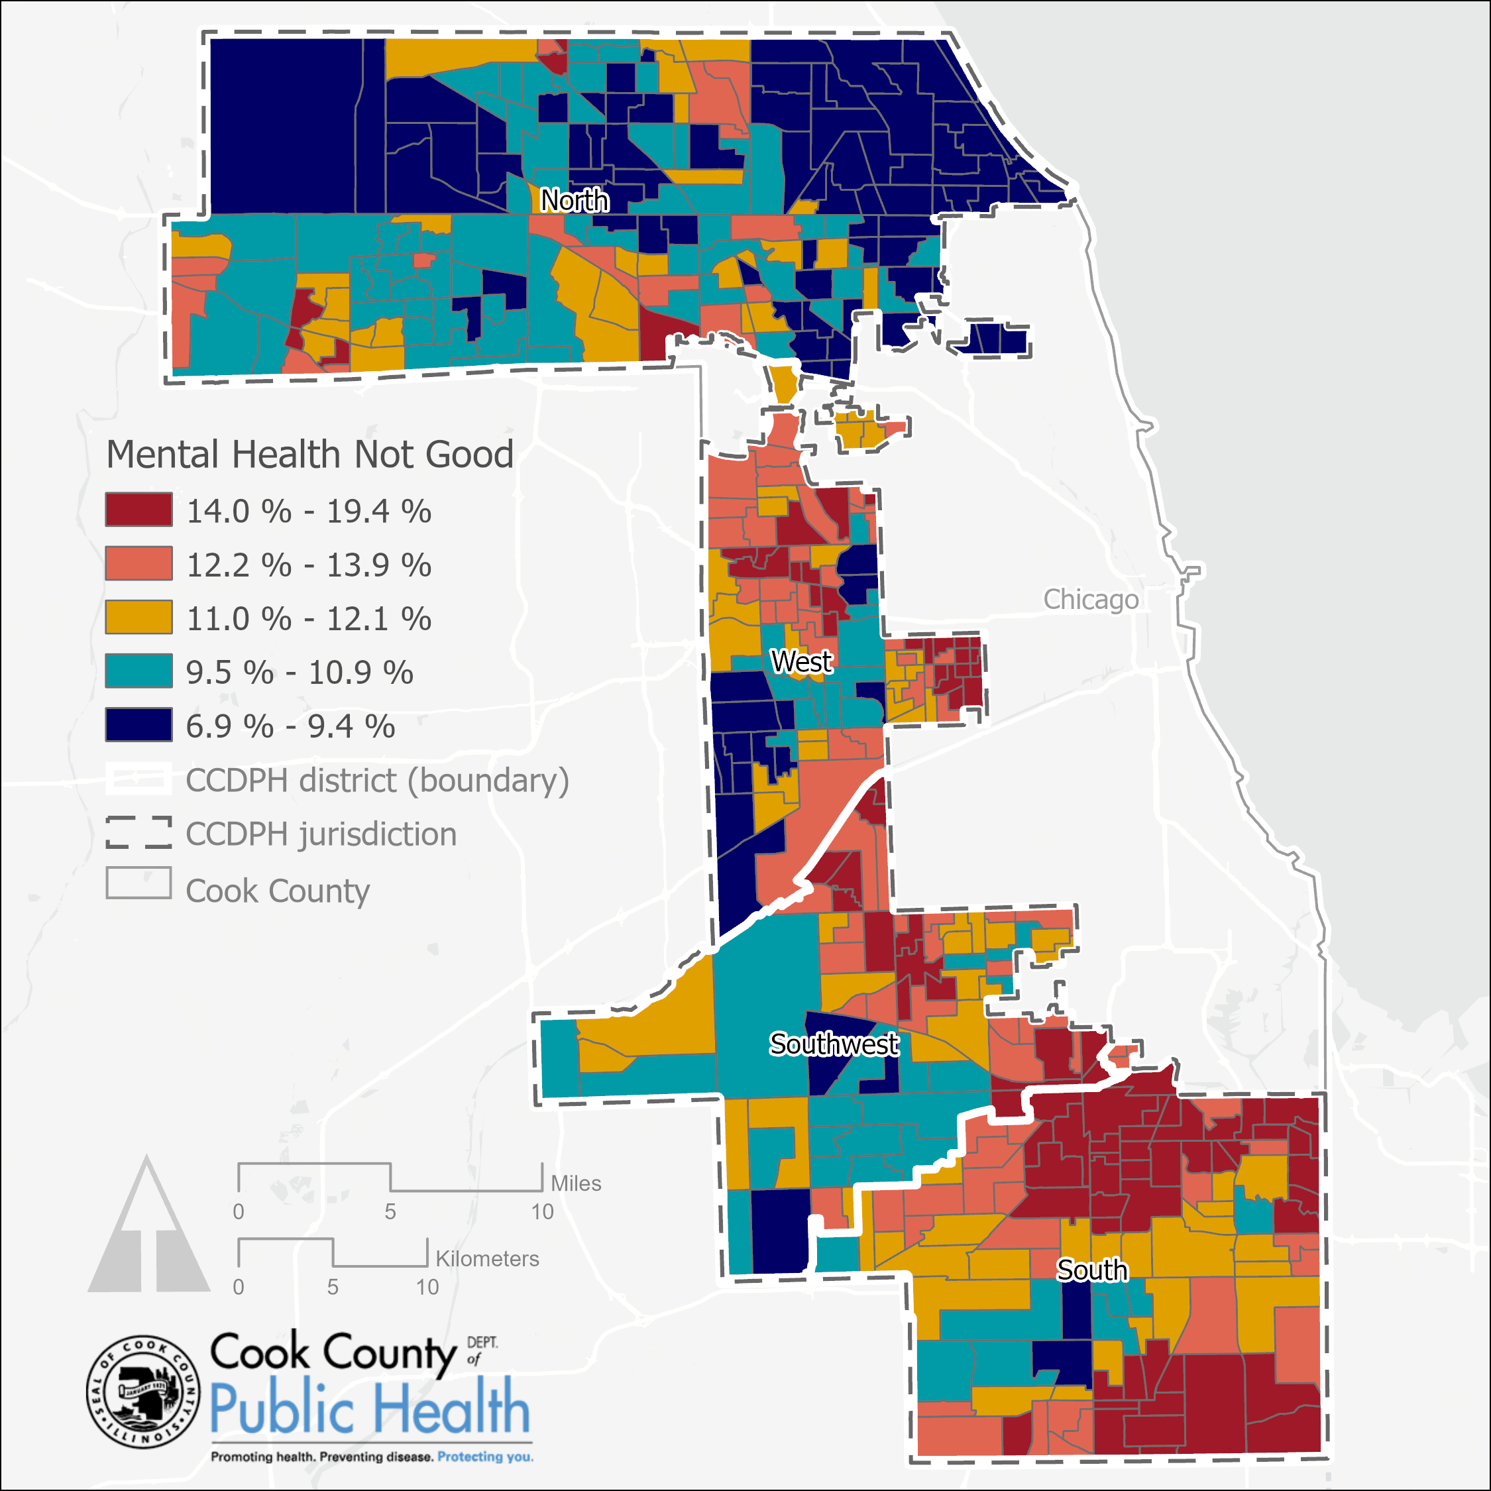
Percent with Mental Health Not Good
While the distribution of census tracts reporting poor mental health varies throughout Suburban Cook County, the north district contains the highest concentration of census tracts with low rates of poor mental health, and the south district contains the highest concentration of census tracts reporting poor mental health.
Data source: CDC PLACES (2020); US Census Bureau TIGER/Line shapefiles (2019); CCDPH

Slide 21
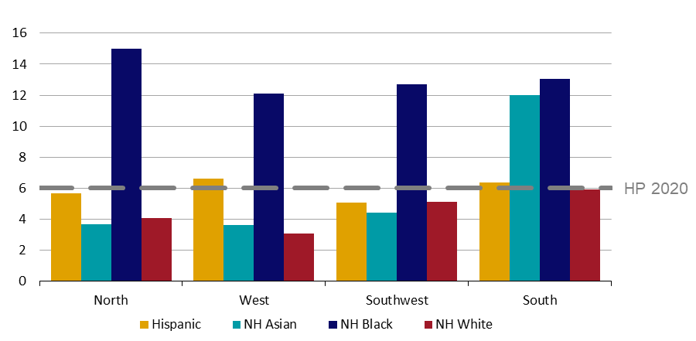
CHSA| Health Behaviors & Outcomes
Mortality, Illness, and Injury:
Infant Mortality Rate
by Race and Ethnicity
and CCDPH District,
2013-2017
Target: 6.0 deaths per 100,000 (Healthy People 2020) Data Source: IDPH Birth File 2013–2017; National Center for Health Statistics, Compressed Natality File 2013–2017.

Slide 22
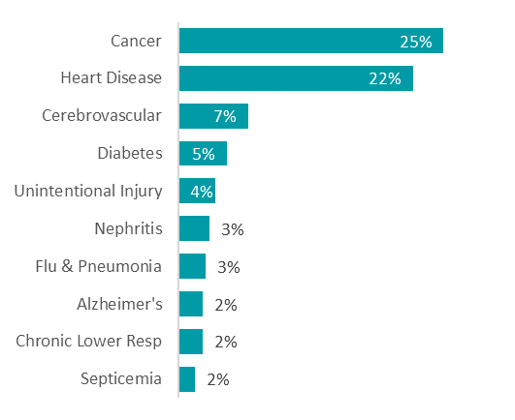
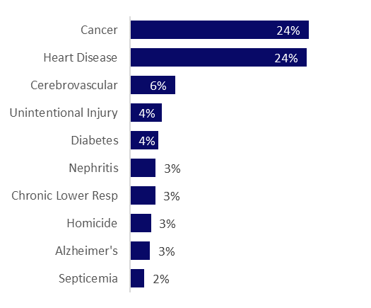
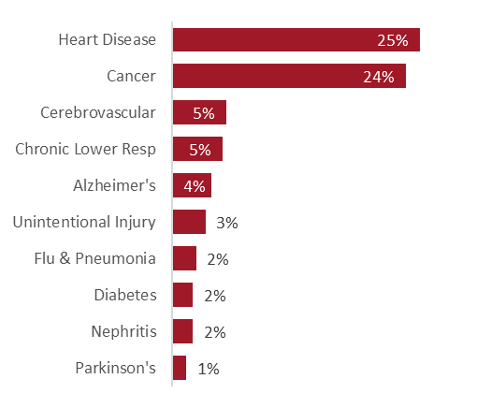
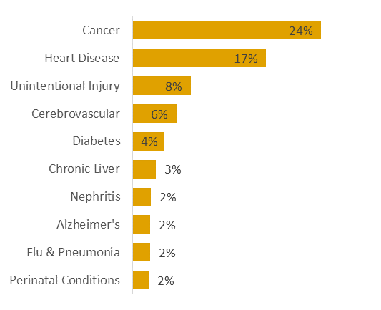
CHSA| Health Behaviors & Outcomes
Leading Causes of Death by Race/Ethnicity, 2013-2017
Asian
Black
White
Hispanic
Data source: IDPH Dealth File, 2013-2017.

Slide 23
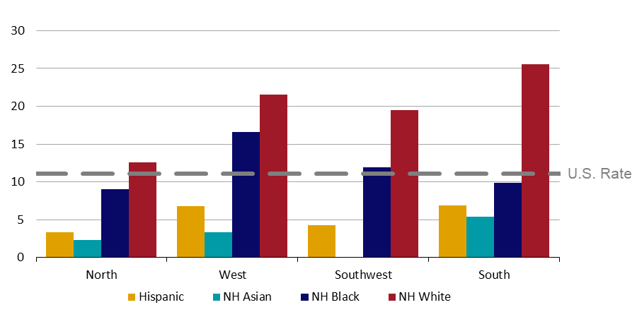
CHSA| Health Behaviors & Outcomes
Mortality, Illness, and Injury:
Opioid Overdose Mortality Rate by Race and Ethnicity
and CCDPH District,
2013-2017
Target: 11.1 deaths per 100,000 (U.S. Rate 2013-2017); Mortality ICD-10 Codes: Underlying Cause X40–X44, X60–X64, X85, Y10–Y14 and Any Cause T40.0, T40.1, T40.2, T40.3, T40.4, or T40; Data sources: Illinois Department of Public Health (IDPH) Death File, 2013-2017; National Center for Health Statistics, Compressed Mortality File 2013-2017

